Slide 1
topic:
Data analysis and output
data storage ,classification and reclassification measurements.
by Hira sahar
Kainat
Sidra aziz

Slide 2




CONTENTS
data analysis and output
data classsification and reclassificcation method
data storage

Slide 3
Data Analysis and Output in GIS

Slide 4
Introduction
Definition of GIS: Geographic Information System (GIS) is a system designed to capture, store, manipulate, analyze, manage, and present spatial or geographic data.
Importance of data analysis and output in GIS: Data analysis allows us to derive insights from spatial data, while output enables the communication of these insights effectively.

Slide 5
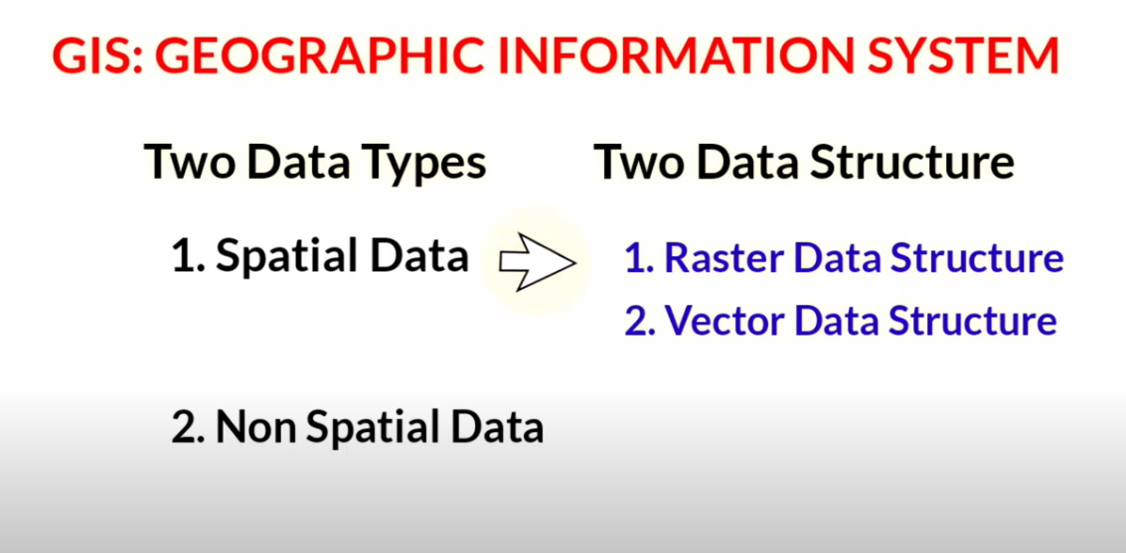
Data Analysis
Understanding Spatial Data
Definition: Spatial data refers to any data that is associated with a specific geographic location or area on the Earth's surface.
two type of data structre are used to display spatial data structure
Vector and raster data structure.

Slide 6
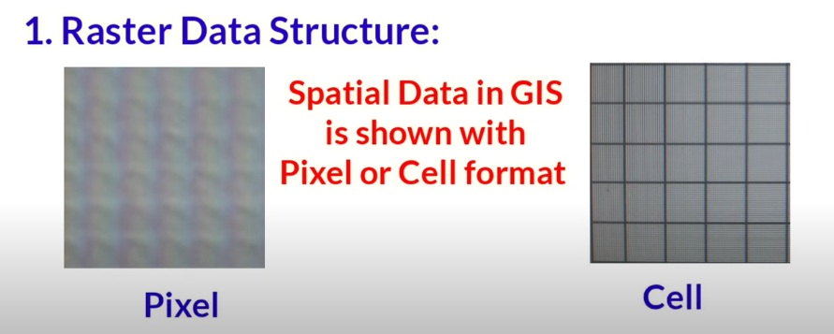
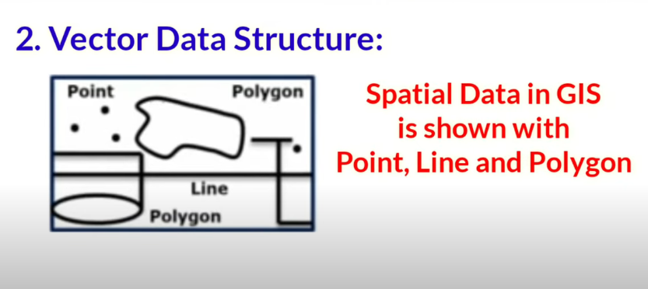

Slide 7
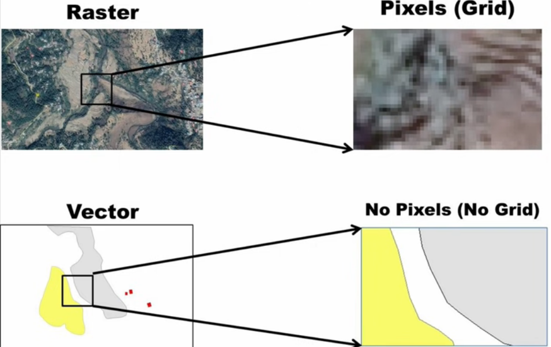
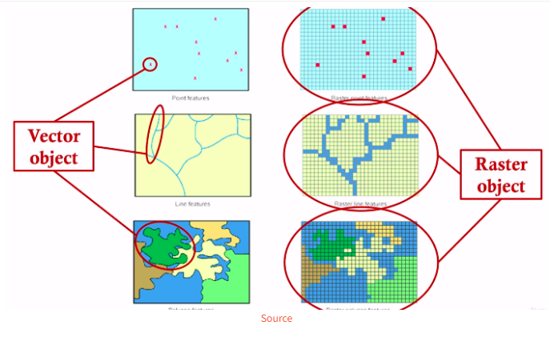
example of raster and vecter

Slide 8
Spatial data Analysis and Techniques
Definition: Spatial analysis involves examining and interpreting spatial data to understand relationships, patterns, and trends within geographic information.
Performing operations like Spatial query, overlay, buffer, and proximity analysis

Slide 9
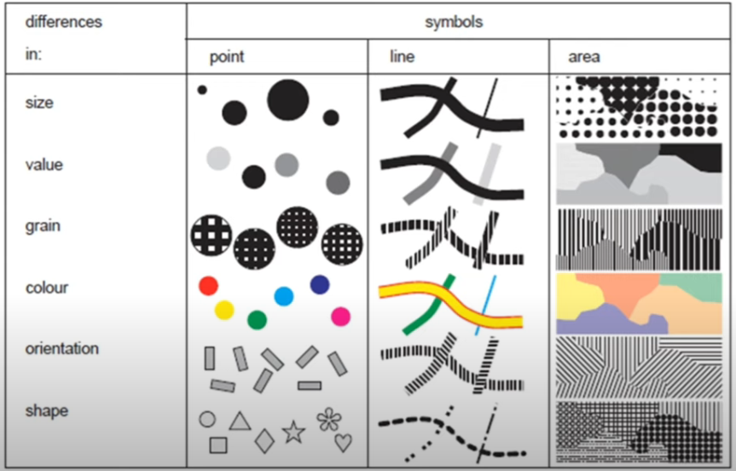
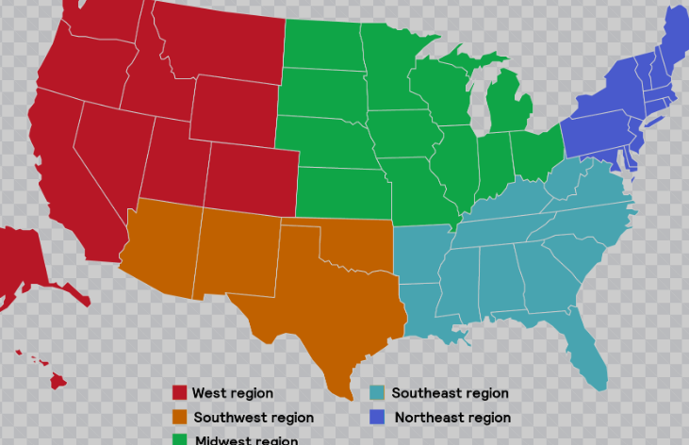
Data Output
Visualization Techniques
Definition: Visualization techniques involve representing spatial data visually to enhance understanding .
for example:maps, symbology, color coding
Presentation Formats
Definition: Presentation formats refer to the various ways in which analyzed data can be presented, such as maps, charts/graphs, and reports.

